Slide 1
Price Prediction model for e-bikes
Data : https://www.greenfinder.de/e-bikes/models/#/product_preview/13176
csv file ,Data include 2147 entries and 30 attributes
Python Tools: Pandas, Numpy, Matplotlib, Sklearn, Seaborn
Names | Mr.Sagar Narode
 | Ms.Prachi Kulkarni
 | Ms.Priya Shroff

Slide 2
Model Comparison/Summary
Models | R2(Test) | R2(Train) | RSME
Linear Regression | 0.31 | 0.35 | 1365
Decision Tree | 0.54 | 0.99 | 1113
Ada boost | 0.46 | 0.53 | 1271
Random Forest | 0.68 | 0.83 | 927

Slide 3
Data Extraction
Step-1 : We scraped data from greenfinder website.
Step-2: The data that we scraped contains the following info:
General info
Engine
Gearshift/Brakes
Suspension
Misc
Steps-3: We extracted the data from near about 84 pages where one
page contained 25 entries

Slide 4
Data Preparation
Step-1: The data we extracted was in the form of lists of dictionary
and each lists had attributes combined in a strings.
Step-2: First we did indexing for each lists and separated attributes
using split function.
Step-3: Now we converted the entire data into a data frame and then
stored it into the csv file.

Slide 5
Exploratory Data Analysis
Step-1: We loaded data set using pandas library
Step-2: We performed basic EDA and we check the data types of our data
and we concluded that most of the data is categorical
Step-3: Now we wanted to predict price for e-bikes and price column is
continuous therefore we decided to go with regression model
Step-4: Next we check for missing values in the data and we concluded that
some attributes have missing values.

Slide 6
Step-5: Then we performed univariate analysis and we did missing
values imputation , for categorical data we use strategy as
most frequent and for continuous we used mean as the strategy
Step-6: Then we performed Label Encoding for categorical data and
converted categorical data into binary form.
Step-7: We checked the correlation between different attributes using
Heatmap
Step-8: Then we splited the data into train set and test set using
train_test_split from sklearn library

Slide 7
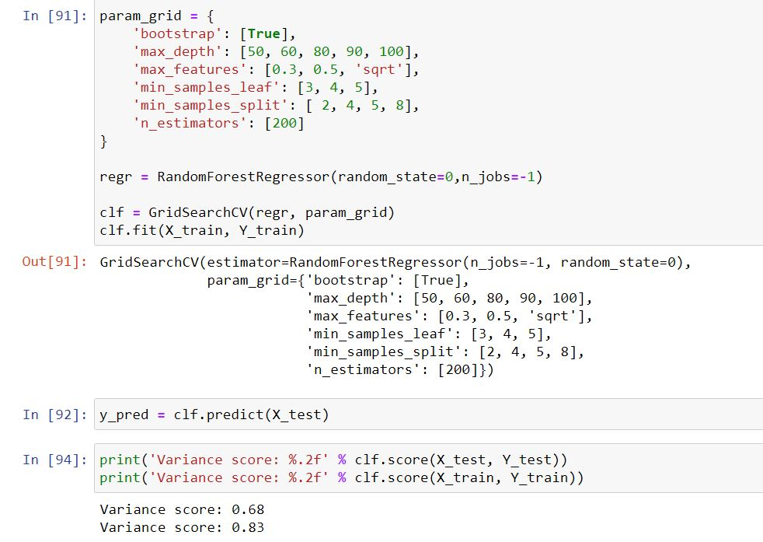
Best Model

